Slide 1

How Air Pollution Is Affecting Our Health
Environmental Science Institute
Susan Lyon Stone
US EPA Office of Air Quality Planning and Standards
stone.susan@epa.gov

Slide 2
Overview
Ozone
Particle pollution
Air Quality Index (AQI)

Slide 3
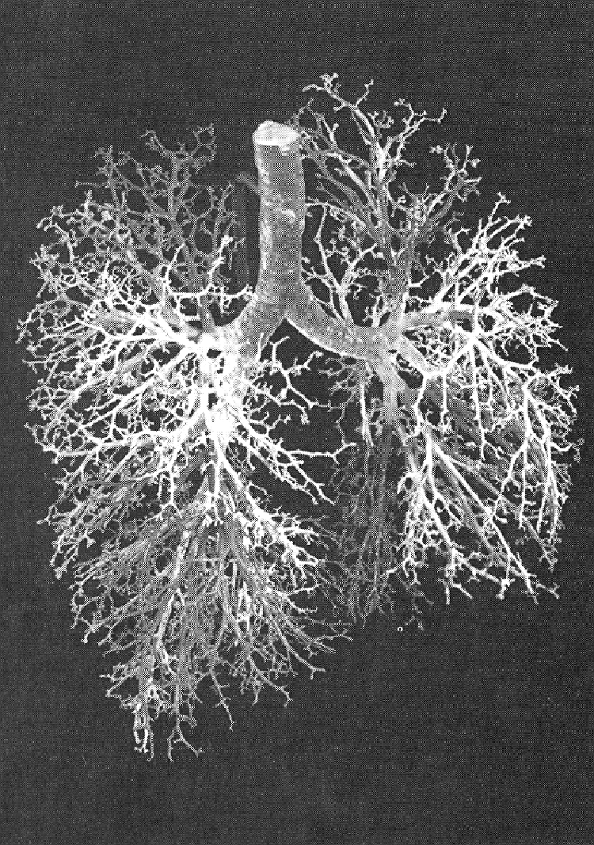
Human Lung
Air conducting
  Trachea
  Bronchi
  Bronchioles
Gas exchange
  Respiratory bronchioles
  Alveoli

Slide 4
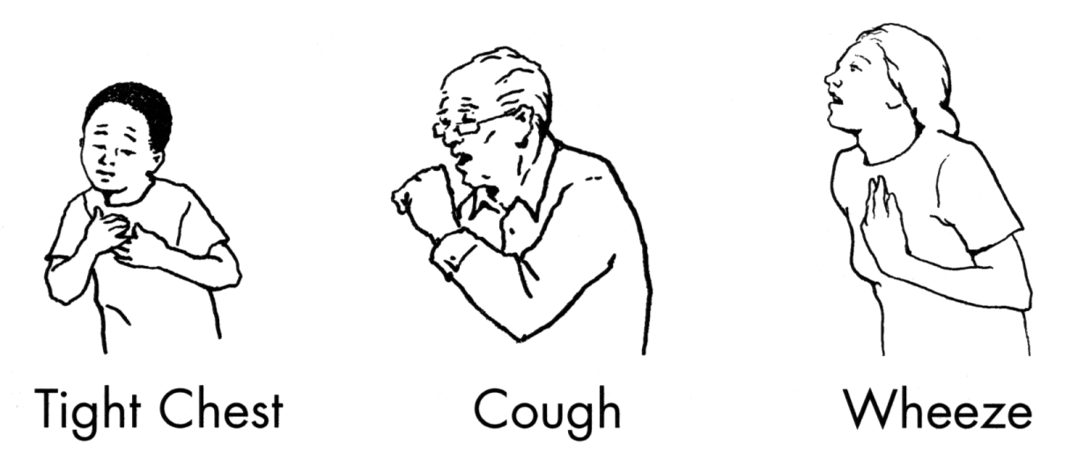
Ozone Irritates Airways
Symptoms
  Cough
  Sore or scratchy throat
  Pain with deep breath
  Fatigue
Rapid onset
Similar symptoms - people with and without asthma
Notes:
Ozone is a powerful oxidizing agent that irritates the airways, producing
Symptoms
Cough
Sore or scratchy throat
Pain when taking a deep breath – this may feel like a stitch in your side that doesn’t go away when you warm up – prevents you from taking a full deep breath
Fatigue – inability to carry on with normal energy levels
Symptoms come on quickly and are temporary, going away within a few hours
Even though some of the symptoms are like the symptoms of asthma, they can occur in people who do not have asthma

Slide 5
Ozone Reduces Lung Function
0
-20
FEV1, % CHANGE
-40
-60
BASELINE
2HR
4HR
M-10
Notes:
Another effect that comes on quickly is the reduction in lung function – this occurs when the smooth muscles that surround the airways contract
By lung function, we usually refer to the amount of air that can be exhaled after a full deep breath (FVC), and the speed at which the air can be exhaled (FEV1); ozone can reduce both of these measures of lung function
Controlled human exposure study: Vertical axis the percent reduction in FEV1 and horizontal axis duration of exposure; more subject in this study, for simplicity we showing the results of the subjects with the smallest, largest and intermediate responses
The first thing you notice magnitude of the reduction in lung function (about 50%)
Medium reduction in lung function (>10-20% reduction FEV1) perceptible wheeze or chest tightness
Large reduction in lung function (>20% FEV1) – obvious wheeze, marked chest tightness and breathing distress, brochodilator required to resolve symptoms
Incapacitating reduction in lung function (>>20% FEV1, or less than 50% of predicted lung function), severe breathing distress, possible emergency treatment required if persistent
The second thing you notice is that while one person is stopped in their tracks, another person had no change at all. Typical of these studies – variability in responsiveness to ozone – brought these people back into the lab
One interesting thing is that we can’t predict who will be “unusually sensitive to ozone” – it’s not based on gender or any other known factor
People with asthma have the same range of responsiveness to asthma -- we say that they are more sensitive because they often have poorer lung function to begin with

Slide 6
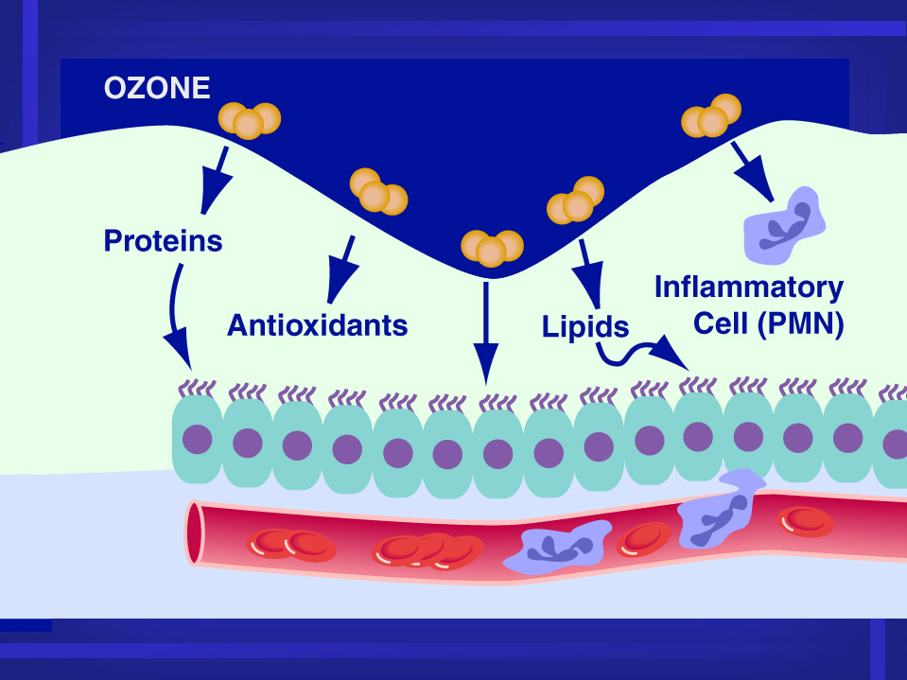
M-1c
Notes:
Ozone can cause inflammation
This is a schematic of an upper airway - BAL
Ciliated epithelial cells, underlying tissue, blood vessel and RBC (red), WBC (blue), white layer on top epithelial lining fluid
Ozone is a very reactive gas that primarily reacts with proteins and lipids in the ELF forming reactive oxygen species (e.g., lipid peroxides). Only in places where the epithelial lining fluid is thin does ozone damage the epithelium directly There is some evidence that taking antioxidants will mitigate the effects. Once the damage occurs white blood cells start to influx to the area and inflammation occurs
We compare this inflammation to the inflammation you get on your skin with a sunburn
Swelling, redness
Doesn’t occur right away
Cells that line the airways die, are sloughed off and replaced new ones
In people with asthma this inflammation can lead to increased airway reactivity – real life
Concern that repeated episodes of damage and healing may result in permanent structural changes in the lung “airway” resulting in reduced lung growth in children, and reduce quality of life in everyone

Slide 7
Ozone Causes Inflammation
Ozone reacts completely in surface layer - forms reactive oxygen molecules
Influx of white blood cells
Damages cells that line the airways
Effect is greater 24 hours after exposure
Increases airway reactivity
Concern about repeated exposures
Notes:
Cycles of injury and healing may lead to permanent structural changes - “airway remodeling”
Children may experience slower lung growth
Permanent changes may reduce the quality of life

Slide 8
Respiratory Hospital Admissions by Daily Maximum Ozone Level, Lagged One Day
(Burnett et al, 1994)
114
112
110
108
106
104
102
Respiratory Admissions
.01 .02 .03 .04 .05 .06 .07 .08 .09 .1
Ozone concentration (ppm)
D-8a
Notes:
This graphic is from an epidemiology study by Burnett from Environment Canada
Vertical axis are respiratory hospital admissions; horizontal axis are ozone concentrations in ppm
Shows that hospital admissions for all respiratory causes were higher following days when ozone levels are high
Even though the total number of hospital admissions are small this illustrates the lack of a threshold for effects even at very low levels of ozone

Slide 9
Lung Function and Respiratory Symptom Effects in Asthmatic Children
Lung function (PEF)
National Cooperative Inner-City Asthma Study (NCICAS) (Mortimer et al., 2002) daily peak flow measurements
  846 asthmatic children, 8 urban areas, morning and evening PEF measurements, 8-hr ozone (10 AM – 6 PM), June through August
  Incidence of ≥ 10% decrements in morning PEF associated with 30 ppb increase in 8-hr average ozone
Respiratory Symptoms
NCICAS (Mortimer et al., 2002), daily diary of symptoms
  Morning symptoms (i.e., cough, chest tightness, wheeze) associated with 30 ppb increase in 8-hr average ozone
Gent et al., (2003); diary study of 271 asthmatic children in southern New England
  130 children used maintenance medications (moderate to severe asthma) and 141 who did not (mild asthma), symptoms (i.e., chest tightness, wheeze, shortness of breath)
  Statistically significant effects on symptoms seen in children on maintenance medication
Notes:
NCICAS – June through August 1993; 8 locations: St. Louis, MO; Chicago, IL; Detroit, MI; Cleveland, OH; Washington, DC;
Baltimore, MD; East Harlem, NY; and Bronx NY

Slide 10
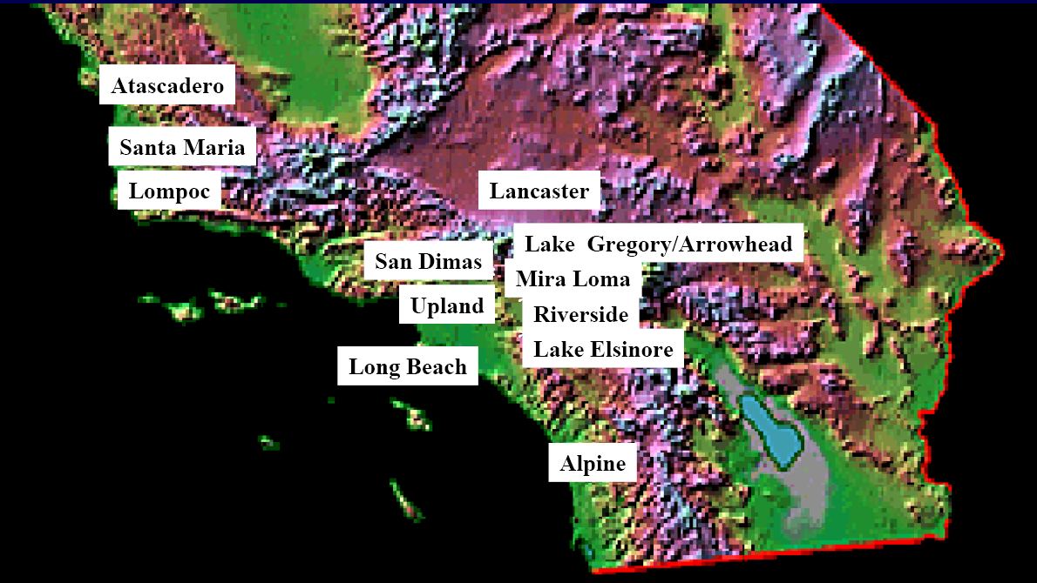
California Children’s Health Study

Slide 11
CHS: School Absences
20 ppb increase in O₃ associated with an 83% increase in school absences for acute respiratory disease (Gilliland et al., 2001)
Large economic impact of pollution-related school absences (Hall and Lurmann, 2003)

Slide 12
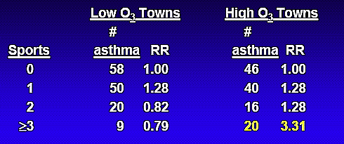
CHS: Ozone and New-onset Asthma
McConnell et al., 2002

Slide 13
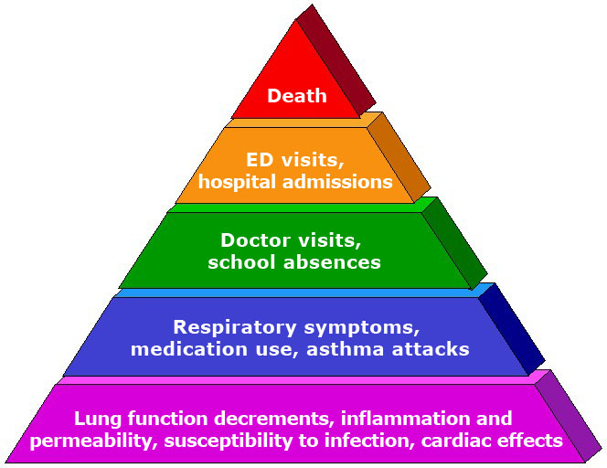
“Pyramid of Effects”
Consistent and coherent effects seen across a wide range of health outcomes
Sensitive groups include:
  Asthmatic children and other people with lung disease
  All children and older adults, especially people active outdoors
  Outdoor workers
Adversity of Effects
Proportion of Population Affected
Notes:
In evaluating health evidence we look for consistency and coherence
Consistency – consistent results across studies
Coherence – logical ordering of effects (pyramid)
Evidence comes from 3 types of studies [with different strengths and weaknesses]
1. Animal toxicology
Exposures/doses controlled, uniform population, confounders controlled
Issues with extrapolation to humans; high doses often used
2. Controlled human exposure
Exposures and confounders controlled (not real-world exposures), not long-term exposures
Generally use healthy subjects or people with mild diseases, health outcomes less severe
3. Epidemiology
Real-world exposures (short- and long-term), including sensitive groups
Issues with potential confounders, exposure error, etc.

Slide 14
Sensitive Groups for Ozone
People with lung disease
Children
Older adults
People who are active outdoors

Slide 15
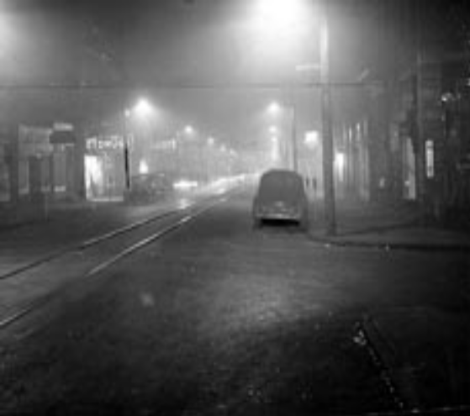
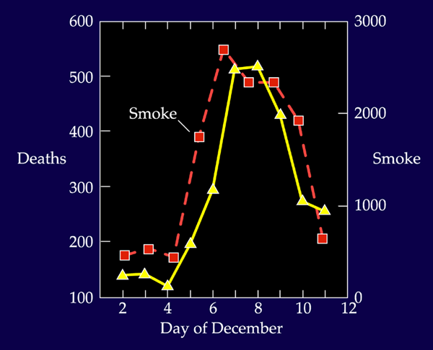
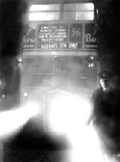
Air Pollution Disasters
Donora, PA at noon on
Oct. 29, 1948
London buses are escorted by lantern at 10:30 in the morning.

Slide 16
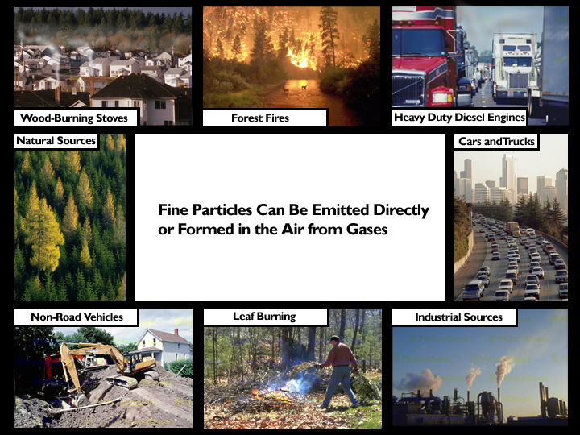
Particle pollution is
a complex mixture
derived from
many sources

Slide 17
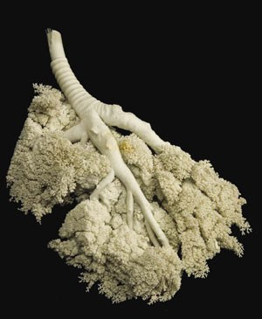
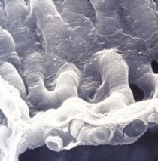
Particle Deposition
Larger particles (> PM₁₀) deposit in the upper respiratory tract
Inhalable particles (< PM₁₀) penetrate into lungs
Some particles (e.g., less than 0.1 um) may enter bloodstream
Particles may react, accumulate, be cleared or absorbed

Slide 18
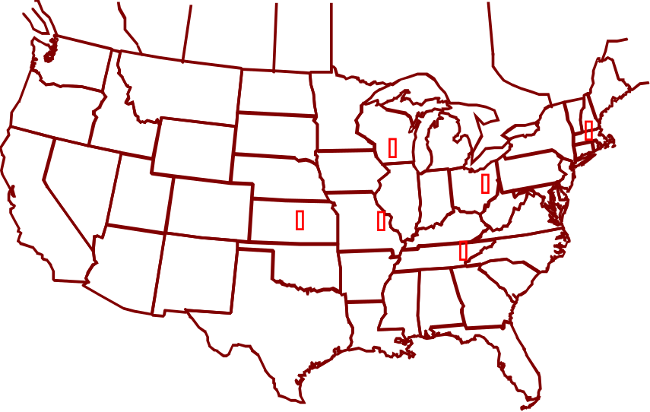
Association Between Long Term Exposure to PM and Mortality
Harvard Six-Cities Adult Cohort
Purpose was to study the association between pulmonary changes and long term exposure to sulfates and sulfur dioxide
Enrollment 1974 – 1977
8,111 white men and women
About 1,300 in each of six cities
Age range 25 to 74 years
Followed until 1991 (now 1999)
14 to 17 years of follow-up
111,076 person-years
1,430 deaths

Slide 19
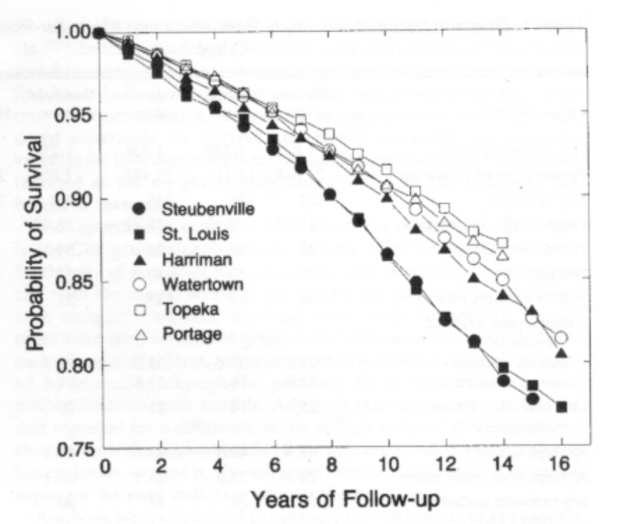
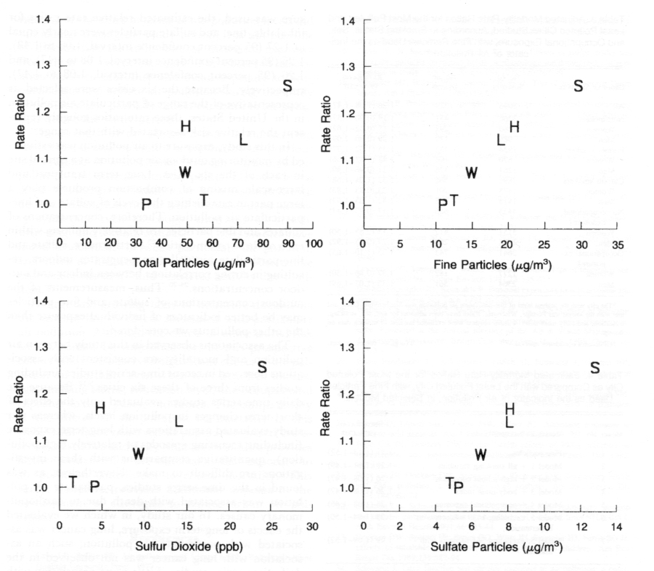
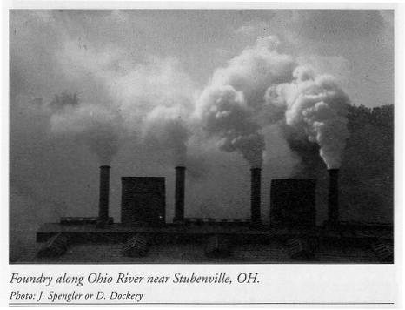
Dockery et al., 1993

Slide 20
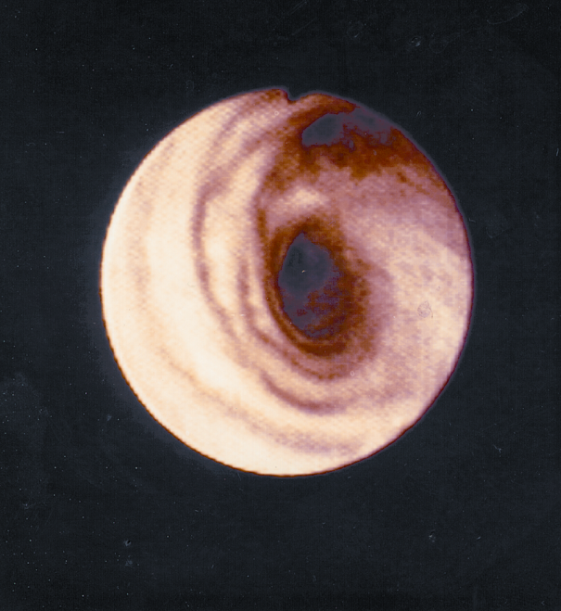

Particle Pollution Affects the Lungs
You are exposed to particle pollution simply by breathing polluted air.
Exposure increases when you exercise, because you breathe more vigorously and deeply than usual.
Respiratory effects include:
  Airway irritation
  Cough
  Phlegm
  Decreased lung function
  Airway inflammation
  Asthma attacks
  Bronchitis
  Chronic bronchitis

Slide 21
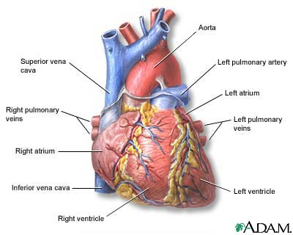
And Particle Pollution Affects the Heart
Particle pollution has been linked to changes that indicate your heart isn’t as healthy as it should be. Those include:
  Arrhythmias and changes in heart rate.
  Changes in the variability of your heart rate.
    Blood component changes
      C-reactive protein
      Fibrinogen
      Plasma viscosity
    Some studies indicate that particle exposure may cause heart attacks. And particles are linked with death from heart disease.
Particle exposure
has been linked
to heart attacks.

Slide 22
It’s a Public Health Concern
When particles aggravate heart and lung diseases that means increases in:
  Hospital admissions
  Doctor and emergency room visits
  Medication use
  Absences from work or school
Particulate matter is linked to significant public health risks – including premature death from heart and lung disease.

Slide 23
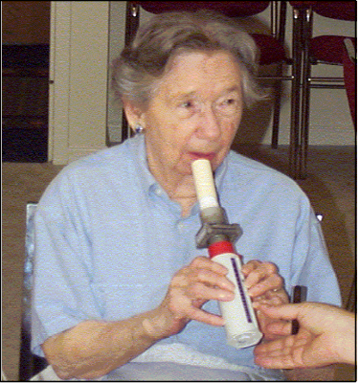
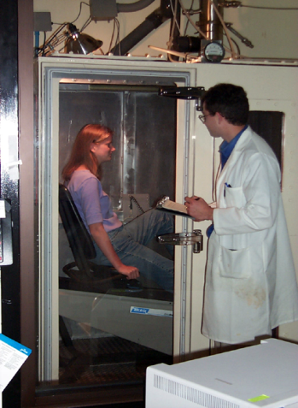
PM Can Cause Effects in Healthy People
150
*
100
PMNs (x10,000)
*
50
*
0
2.9
47.2
107.8
206.7
Average CAPS Concentration (μ/m³)
4
Air
3
CAPS
Ratio CAPS / Pre
2
*
1
*
0
Ghio et al., 2003
SDNN
PNN50
LF
HF
Total
Ratio
Devlin et al., 2003

Slide 24
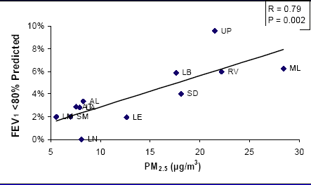
CHS: Low FEV₁ at Age 18 vs. Pollution
Gauderman et al., 2004

Slide 25
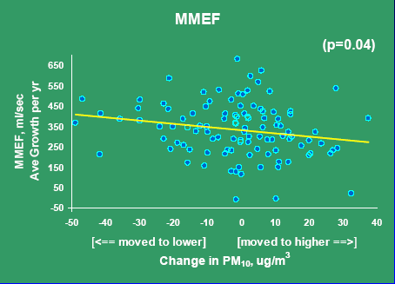
CHS: Lung Function Growth in Movers
Avol et al., 2001

Slide 26
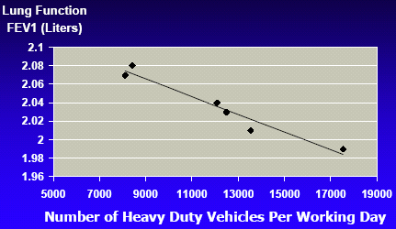
Living Within 300 Meters of Local Roadways Affects FEV₁
Brunekreef et al., 1997

Slide 27
Traffic Exposures
Traffic exposure linked to respiratory symptoms in several European studies
San Francisco bay area study linking pollution exposures at schools to symptoms (Kim et al., 2004)
CHS study of residential NO₂, traffic linked to asthma prevalence, symptoms, and medication use (Gauderman et al., 2005)

Slide 28
Sensitive Groups for PM
People with heart disease
People with lung disease
Older adults
Children

Slide 29
Air Quality Index
Descriptors | Cautionary Statement
Good 0 – 50 | No message
Moderate 51 – 100 | Unusually sensitive individuals
Unhealthy for Sensitive Groups 101 - 150 | Identifiable groups at risk - different groups for different pollutants
Unhealthy 151 - 200 | General public at risk; sensitive groups at greater risk
Very Unhealthy 201 - 300 | General public at greater risk; sensitive groups at greatest risk

Slide 30
Use AQI to Reduce Risk
Dose = Concentration x Ventilation Rate x Time
Reduce these factors to reduce dose
Pay attention to symptoms
People with asthma – follow asthma action plan
Coaches – rotate players frequently
People with heart disease
  Check with your doctor
  Don’t exercise near busy roads
Notes:
Most of you know how to use the Air Quality Index, or AQI, to reduce the risk from exposure to ozone
Dose of particles is calculated exactly the same way as a dose of ozone

Slide 31
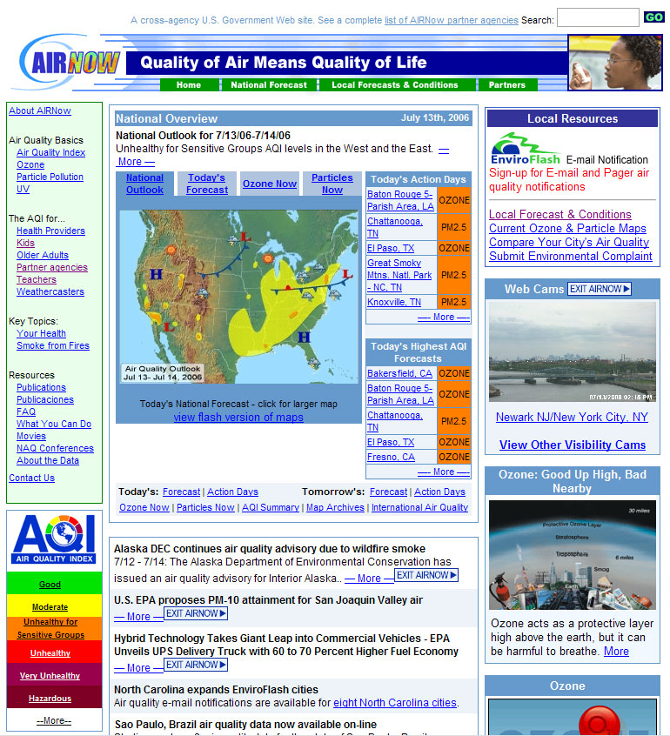
AIRNow Web site http:www.airnow.gov

Slide 32
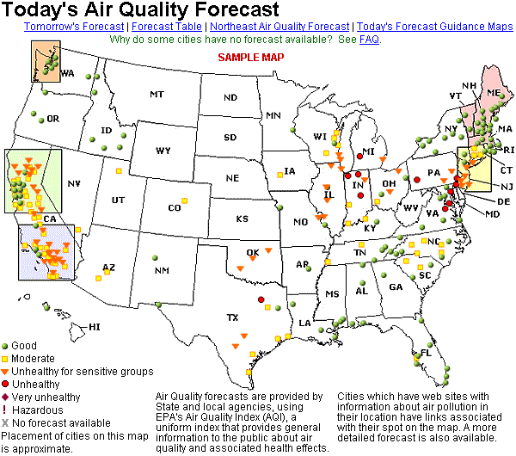
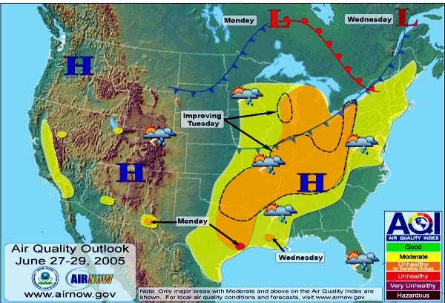
Air Quality Forecasting
Daily
Two-Day Outlook

Slide 33
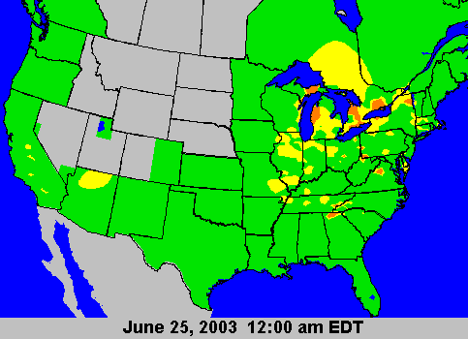
Real-Time Air Quality Mapping
Notes:
Through the AIRNOW program, numerous products are already being utilized in local weathercasts…
Real-time ozone animations updated hourly throughout the day showing current ozone levels.
Next-day ozone air quality forecasts for almost 300 cities across the United States.
All of this information is currently available to you via the AIRNOW website, but also through your state and local agencies.

Slide 34
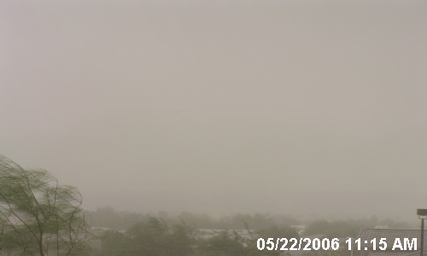
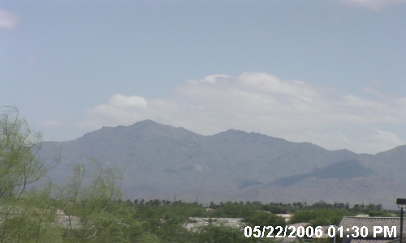
Web Cameras
Phoenix, Arizona

Slide 35

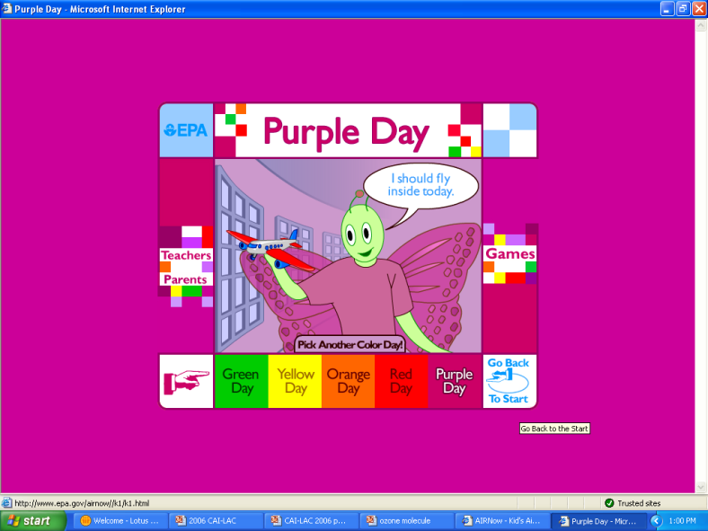

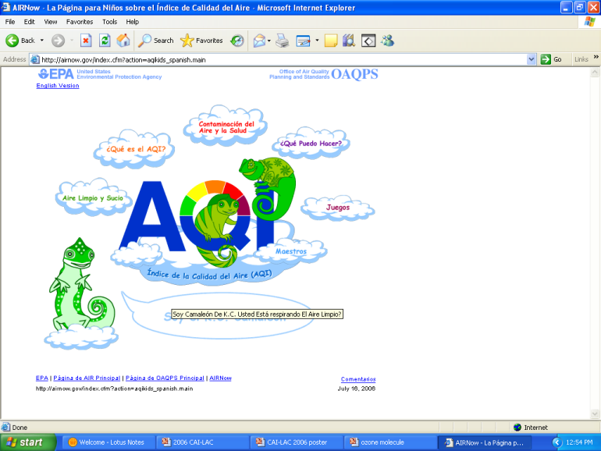
Teacher Curricula

Slide 36


Publications

Slide 37
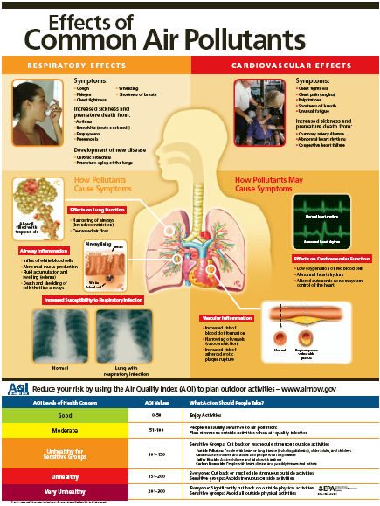
Medical
Poster

Slide 38

Ozone Web Course

Slide 39
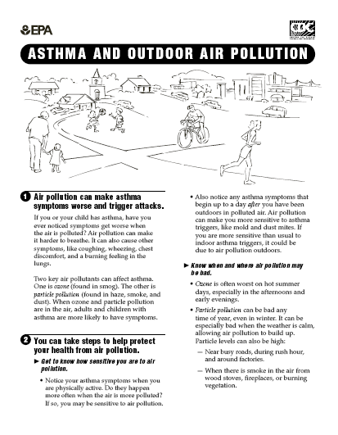
Asthma Factsheet

Slide 40
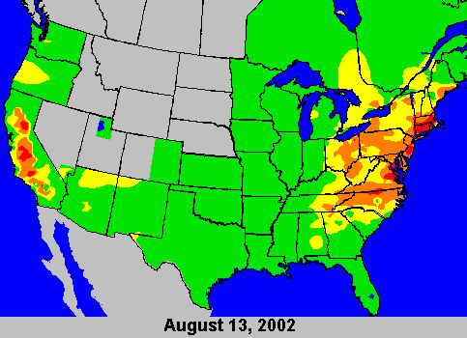

An Hour in the Life of an AIRNow Ozone Molecule

Slide 41
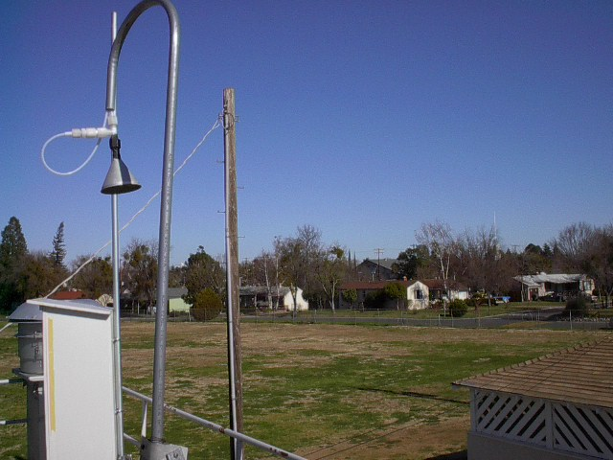
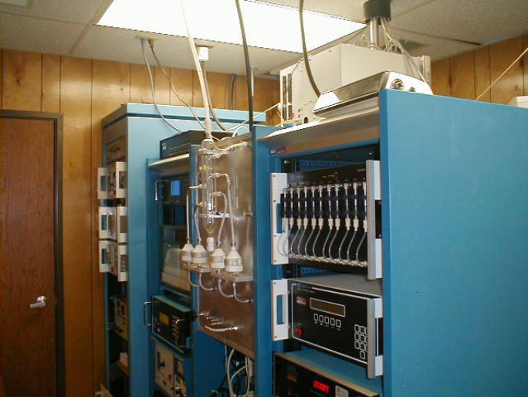
The journey begins…..
9:59:59
10:00:01

Slide 42

First stop: AQ Agency
89
34
START_REF, 0
NUMSTEPS, 24
AVG_TIME, 60
UNITS, PPB
STATIONS, 1342
! START HOUR
! ID AIRS CODE 0000 0100 0200 0300 0400 0500 0600
!------------------- --------- ---- ---- ---- ---- ---- ---- ---- ---- ---- ---- ----
BEGIN_DATA
ST. J ,000010102, 5, 12, 7, 3, 2, 2, 7, 6, 9, 5, 6
ST. J ,000010102, G, G, G, G, G, G, G, G, G, G
Corne ,000010301, 13, 13, 10, 6, 5, 7, 14, 16, 18, 22
Corne ,000010301, G, G, G, G, G, G, G, G, G,
WELLI ,000020301,-999,-999,-999,-999,-999,-999,-999,-999
76
OBS data file
67
39
Stats:
1200 monitors
78 agencies nationwide
Collected every hour
101
10:05:29
10:15:21

Slide 43
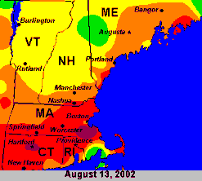
All roads lead to the DMC…
START_REF, 0
NUMSTEPS, 24
AVG_TIME, 60
UNITS, PPB
STATIONS, 1342
! START HOUR
! ID AIRS CODE 0000 0100 0200 0300 0400 0500 0600
!------------------- --------- ---- ---- ---- ---- ---- ---- ---- ---- ---- ---- ----
BEGIN_DATA
ST. J ,000010102, 5, 12, 7, 3, 2, 2, 7, 6, 9, 5, 6
ST. J ,000010102, G, G, G, G, G, G, G, G, G, G
Corne ,000010301, 13, 13, 10, 6, 5, 7, 14, 16, 18, 22
Corne ,000010301, G, G, G, G, G, G, G, G, G,
WELLI ,000020301,-999,-999,-999,-999,-999,-999,-999,-999
START_REF, 0
NUMSTEPS, 24
AVG_TIME, 60
UNITS, PPB
STATIONS, 1342
! START HOUR
! ID AIRS CODE 0000 0100 0200 0300 0400 0500 0600
!------------------- --------- ---- ---- ---- ---- ---- ---- ---- ---- ---- ---- ----
BEGIN_DATA
ST. J ,000010102, 5, 12, 7, 3, 2, 2, 7, 6, 9, 5, 6
ST. J ,000010102, G, G, G, G, G, G, G, G, G, G
Corne ,000010301, 13, 13, 10, 6, 5, 7, 14, 16, 18, 22
Corne ,000010301, G, G, G, G, G, G, G, G, G,
WELLI ,000020301,-999,-999,-999,-999,-999,-999,-999,-999
START_REF, 0
NUMSTEPS, 24
AVG_TIME, 60
UNITS, PPB
STATIONS, 1342
! START HOUR
! ID AIRS CODE 0000 0100 0200 0300 0400 0500 0600
!------------------- --------- ---- ---- ---- ---- ---- ---- ---- ---- ---- ---- ----
BEGIN_DATA
ST. J ,000010102, 5, 12, 7, 3, 2, 2, 7, 6, 9, 5, 6
ST. J ,000010102, G, G, G, G, G, G, G, G, G, G
Corne ,000010301, 13, 13, 10, 6, 5, 7, 14, 16, 18, 22
Corne ,000010301, G, G, G, G, G, G, G, G, G,
WELLI ,000020301,-999,-999,-999,-999,-999,-999,-999,-999
Oracle
Database
Quality
Control
START_REF, 0
NUMSTEPS, 24
AVG_TIME, 60
UNITS, PPB
STATIONS, 1342
! START HOUR
! ID AIRS CODE 0000 0100 0200 0300 0400 0500 0600
!------------------- --------- ---- ---- ---- ---- ---- ---- ---- ---- ---- ---- ----
BEGIN_DATA
ST. J ,000010102, 5, 12, 7, 3, 2, 2, 7, 6, 9, 5, 6
ST. J ,000010102, G, G, G, G, G, G, G, G, G, G
Corne ,000010301, 13, 13, 10, 6, 5, 7, 14, 16, 18, 22
Corne ,000010301, G, G, G, G, G, G, G, G, G,
WELLI ,000020301,-999,-999,-999,-999,-999,-999,-999,-999
START_REF, 0
NUMSTEPS, 24
AVG_TIME, 60
UNITS, PPB
STATIONS, 1342
! START HOUR
! ID AIRS CODE 0000 0100 0200 0300 0400 0500 0600
!------------------- --------- ---- ---- ---- ---- ---- ---- ---- ---- ---- ---- ----
BEGIN_DATA
ST. J ,000010102, 5, 12, 7, 3, 2, 2, 7, 6, 9, 5, 6
ST. J ,000010102, G, G, G, G, G, G, G, G, G, G
Corne ,000010301, 13, 13, 10, 6, 5, 7, 14, 16, 18, 22
Corne ,000010301, G, G, G, G, G, G, G, G, G,
WELLI ,000020301,-999,-999,-999,-999,-999,-999,-999,-999
010100010001111010010101010101001010011110100100101010010100000111000100101
START_REF, 0
NUMSTEPS, 24
AVG_TIME, 60
UNITS, PPB
STATIONS, 1342
! START HOUR
! ID AIRS CODE 0000 0100 0200 0300 0400 0500 0600
!------------------- --------- ---- ---- ---- ---- ---- ---- ---- ---- ---- ---- ----
BEGIN_DATA
ST. J ,000010102, 5, 12, 7, 3, 2, 2, 7, 6, 9, 5, 6
ST. J ,000010102, G, G, G, G, G, G, G, G, G, G
Corne ,000010301, 13, 13, 10, 6, 5, 7, 14, 16, 18, 22
Corne ,000010301, G, G, G, G, G, G, G, G, G,
WELLI ,000020301,-999,-999,-999,-999,-999,-999,-999,-999
START_REF, 0
NUMSTEPS, 24
AVG_TIME, 60
UNITS, PPB
STATIONS, 1342
! START HOUR
! ID AIRS CODE 0000 0100 0200 0300 0400 0500 0600
!------------------- --------- ---- ---- ---- ---- ---- ---- ---- ---- ---- ---- ----
BEGIN_DATA
ST. J ,000010102, 5, 12, 7, 3, 2, 2, 7, 6, 9, 5, 6
ST. J ,000010102, G, G, G, G, G, G, G, G, G, G
Corne ,000010301, 13, 13, 10, 6, 5, 7, 14, 16, 18, 22
Corne ,000010301, G, G, G, G, G, G, G, G, G,
WELLI ,000020301,-999,-999,-999,-999,-999,-999,-999,-999
START_REF, 0
NUMSTEPS, 24
AVG_TIME, 60
UNITS, PPB
STATIONS, 1342
! START HOUR
! ID AIRS CODE 0000 0100 0200 0300 0400 0500 0600
!------------------- --------- ---- ---- ---- ---- ---- ---- ---- ---- ---- ---- ----
BEGIN_DATA
ST. J ,000010102, 5, 12, 7, 3, 2, 2, 7, 6, 9, 5, 6
ST. J ,000010102, G, G, G, G, G, G, G, G, G, G
Corne ,000010301, 13, 13, 10, 6, 5, 7, 14, 16, 18, 22
Corne ,000010301, G, G, G, G, G, G, G, G, G,
WELLI ,000020301,-999,-999,-999,-999,-999,-999,-999,-999
Stats:
Redundant computer servers
Files processed in seconds
Over 30,000 data values per day
50 maps produced every hour
10:31:45
10:45:21

Slide 44
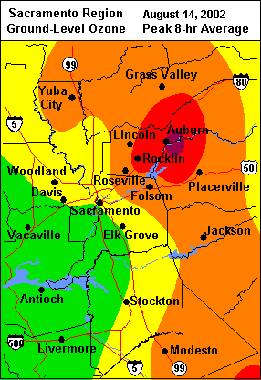









The last leg of the journey….
Public
Weather/News Providers
010100010001111010010101010101001010011110100100101010010100000111000100101
10:45:55
10:55:21
11:00:00

